Slide 1

Man-in-the-Middle Attacks in Public Wi-Fi
Presented by: Nazibur Rahman | ID: 0242220005101410 | Section: 63_B

Slide 2
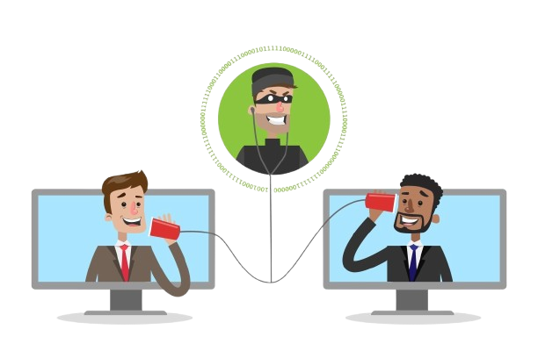
Man-in-the-Middle (MITM) Attacks
A cyberattack where an attacker secretly intercepts and potentially alters communication between two unsuspecting parties. The victim believes they are communicating directly. The attacker positions themselves as an invisible intermediary, allowing them to eavesdrop, capture sensitive data, or even inject malicious content into the communication stream.

Slide 3
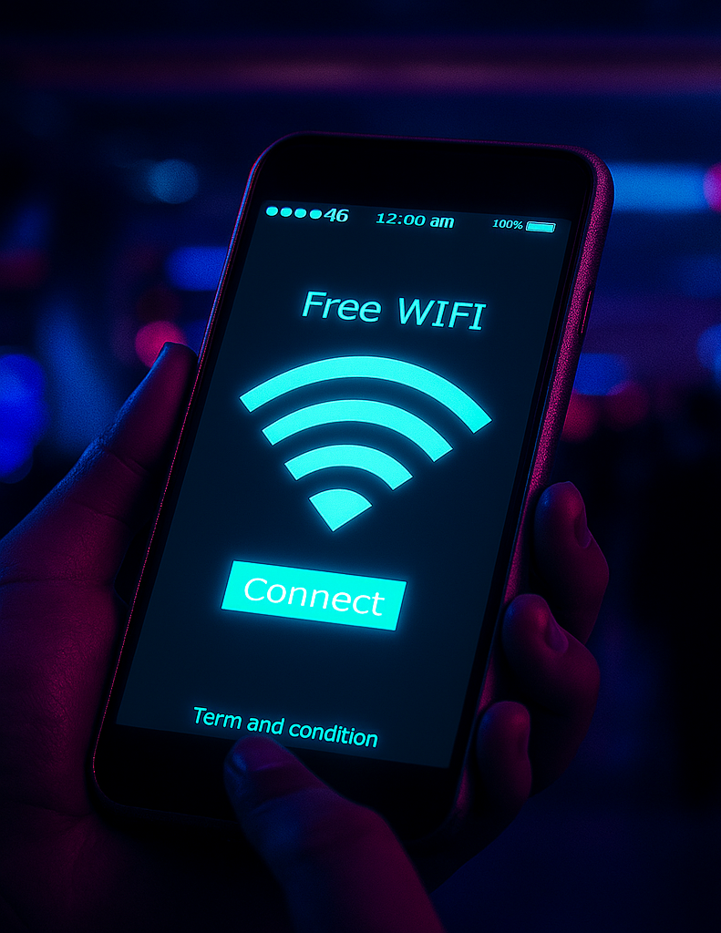
Why Public Wi-Fi Networks Are Vulnerable!
Public Wi-Fi networks inherently pose a greater risk due to several fundamental security weaknesses that attackers can exploit:
Lack of Encryption: Many open networks transmit data without encryption, making it easy for attackers to intercept.
No User Authentication: These networks often lack robust user authentication, allowing anyone to join and potentially monitor traffic.
Shared Network Access: All devices on the network share the same access, enabling attackers to scan for vulnerabilities or impersonate legitimate network components.

Slide 4
How a MITM Attack Unfolds on Public Wi-Fi
1
2
Victim Connects
Attacker Intervenes
A user connects to a seemingly legitimate public Wi-Fi network, such as "Free_Cafe_WiFi."
The attacker positions themselves between the victim's device and the legitimate Wi-Fi router, often through ARP spoofing or by setting up an "Evil Twin" hotspot.
3
4
Traffic Interception
Data Compromise
All data exchanged between the victim and the internet (e.g., login credentials, messages, browsing history) passes through the attacker's device.
The attacker can now steal, alter, or inject malicious content into the intercepted traffic without either party knowing, leading to data breaches or financial fraud.

Slide 5
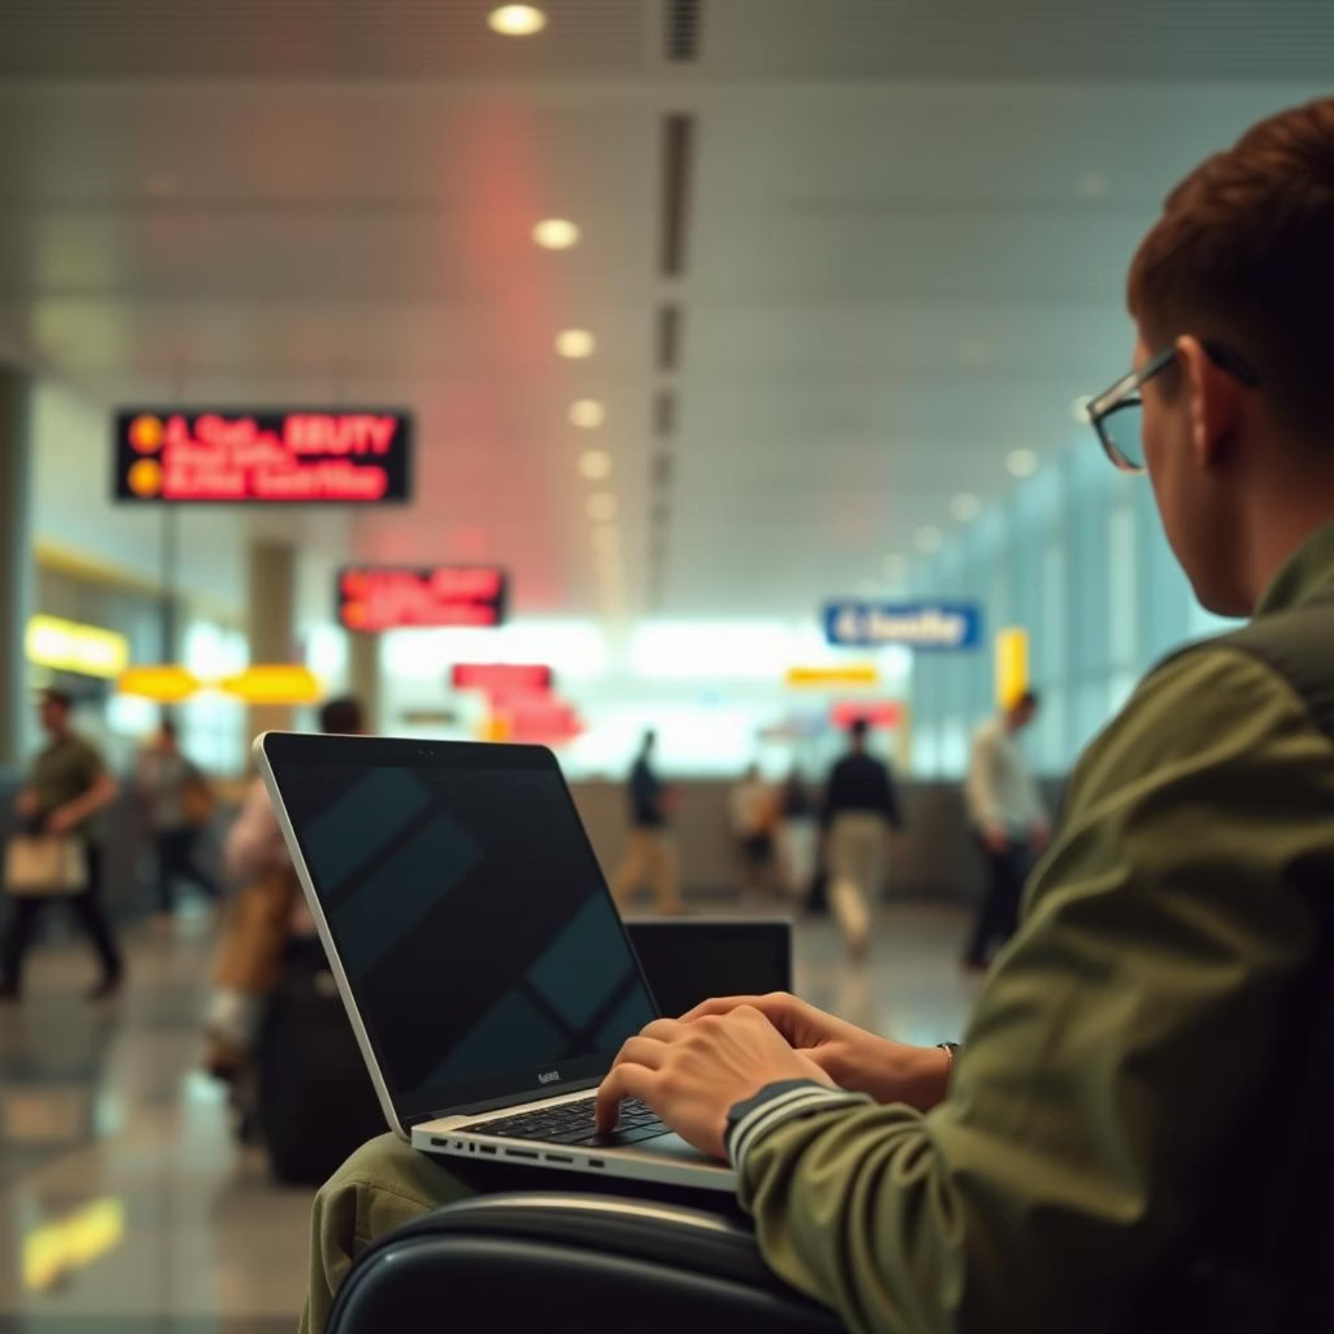
Real-World Scenario:
Imagine you're at a busy airport, eager to check emails before your flight. You see a network called "Free_Airport_WiFi" and connect without a second thought. Unbeknownst to you, this is an "Evil Twin" hotspot set up by an attacker, mimicking the official airport Wi-Fi.
As you log into your email or online banking, the attacker intercepts your credentials, credit card numbers, and other sensitive information. This single act can lead to identity theft, unauthorized financial transactions, and significant personal data loss.

Slide 6




Essential Defenses Against MITM Attacks
Use a VPN
Verify HTTPS
Always connect to a Virtual Private Network (VPN) when using public Wi-Fi to encrypt your internet traffic, creating a secure tunnel.
Ensure websites use HTTPS (Hypertext Transfer Protocol Secure) with a valid SSL certificate, indicated by a padlock icon in your browser.
Avoid Sensitive Activities
Keep Software Updated
Refrain from conducting online banking, shopping, or accessing personal accounts on unsecured public Wi-Fi networks.
Regularly update your operating system, web browser, and antivirus software to patch known vulnerabilities that attackers could exploit.

Slide 7

"In security, awareness is the first defense."
Conclusion:
Man-in-the-Middle attacks remain a significant and evolving threat, especially in the pervasive landscape of public Wi-Fi networks. Their stealthy nature makes them particularly dangerous, as victims are often unaware that their communication is being intercepted or manipulated.
However, with increased awareness and the adoption of fundamental security practices, you can significantly mitigate these risks. Always assume public Wi-Fi is insecure unless explicitly protected by robust encryption like a VPN.

